Slide 1
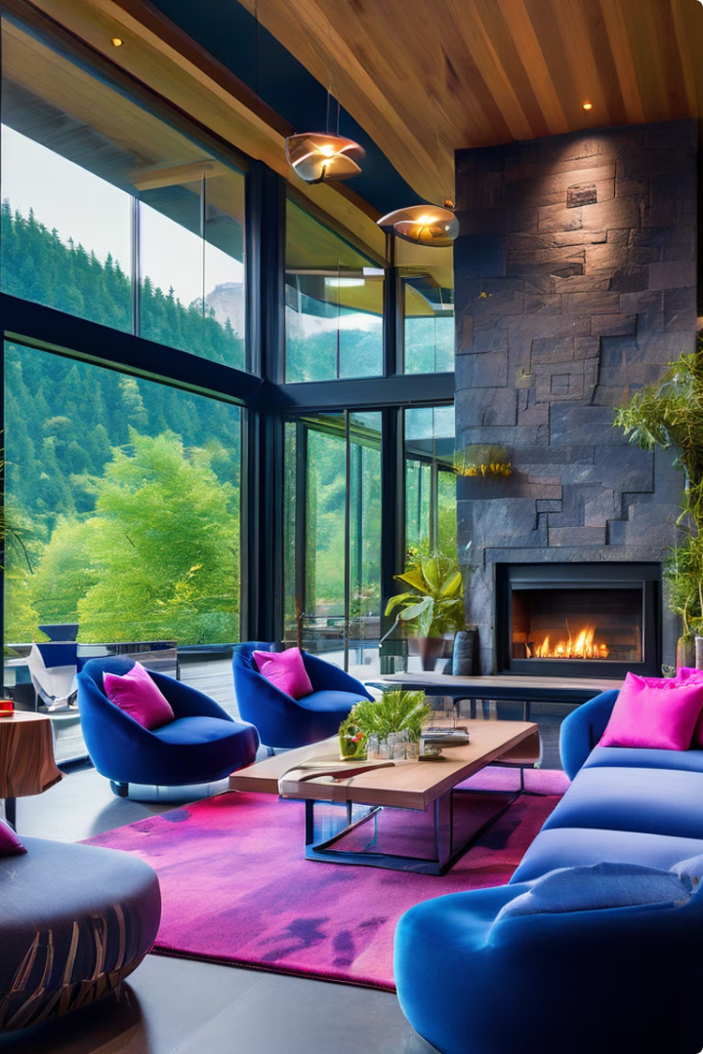

Eco-Luxe Retreats: Redefining Hospitality
Eco-Luxe Retreats offers a unique hospitality experience that seamlessly blends sustainability, comfort, and breathtaking natural beauty. Our mission is to redefine the way travelers connect with the environment while indulging in unparalleled luxury.
by George klaus
Gk

Slide 2

The Problem: Eco-Conscious Travelers Seek More
1
Disconnect from Nature
Many travelers feel disconnected from the natural world during their hotel stays.
2
Lack of Sustainable Options
Eco-conscious travelers struggle to find luxury accommodations that prioritize sustainability.
3
Desire for Authentic Experiences
Guests crave immersive, transformative experiences that go beyond traditional hospitality.

Slide 3
The Solution: Eco-Luxe Retreats
Seamless Sustainability
Immersive Nature Experiences
Elevated Luxury
Our eco-lodges are designed to minimize environmental impact through renewable energy, water conservation, and sustainable materials.
Our accommodations offer world-class amenities and thoughtful design that redefine the concept of luxury.
Guests can enjoy guided hikes, forest bathing, and other activities that foster a deep connection with the natural world.

Slide 4

Vast Market Opportunity
1
Booming Eco-Tourism
2
Shift in Consumer Preferences
3
Underserved Luxury Segment
The global eco-tourism market is expected to grow by 15% annually, reaching $333 billion by 2027.
Travelers, especially millennials and Gen Z, are increasingly prioritizing sustainability and authentic experiences.
There is a lack of high-end, eco-conscious hospitality options, presenting a significant market gap.

Slide 5
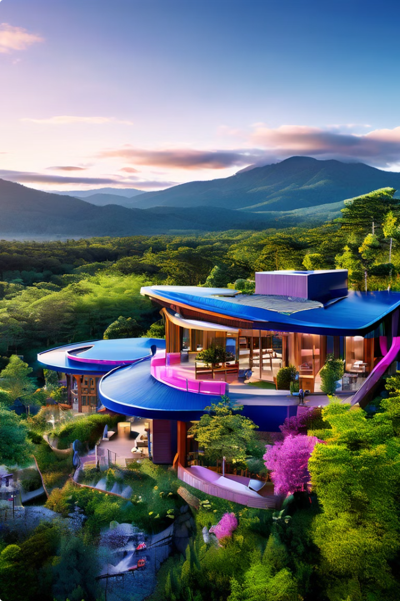




Our Eco-Luxe Offering
Renewable Energy
Our lodges are powered by renewable energy sources, minimizing our carbon footprint.
Water Conservation
Advanced water treatment systems and low-flow fixtures ensure responsible water usage.
Sustainable Materials
We use locally sourced, eco-friendly materials in our construction and furnishings.
Nature Immersion
Guests can explore and connect with the surrounding natural landscapes.

Slide 6
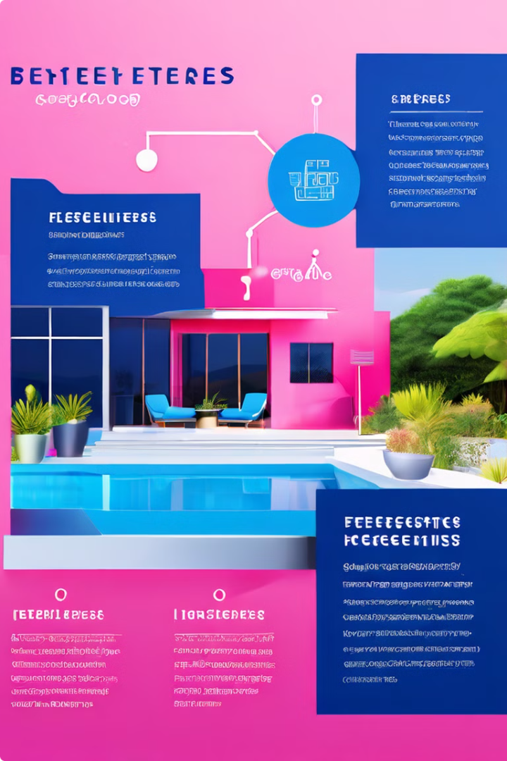
Innovative Business Model
1
Asset-Light Approach
We partner with landowners to develop and manage the eco-lodges, minimizing upfront capital expenditures.
2
Subscription-Based Revenue
Guests can purchase annual memberships, providing a recurring revenue stream and ensuring long-term loyalty.
3
Sustainable Partnerships
We collaborate with eco-conscious suppliers, tour operators, and local communities to deliver a holistic experience.

Slide 7
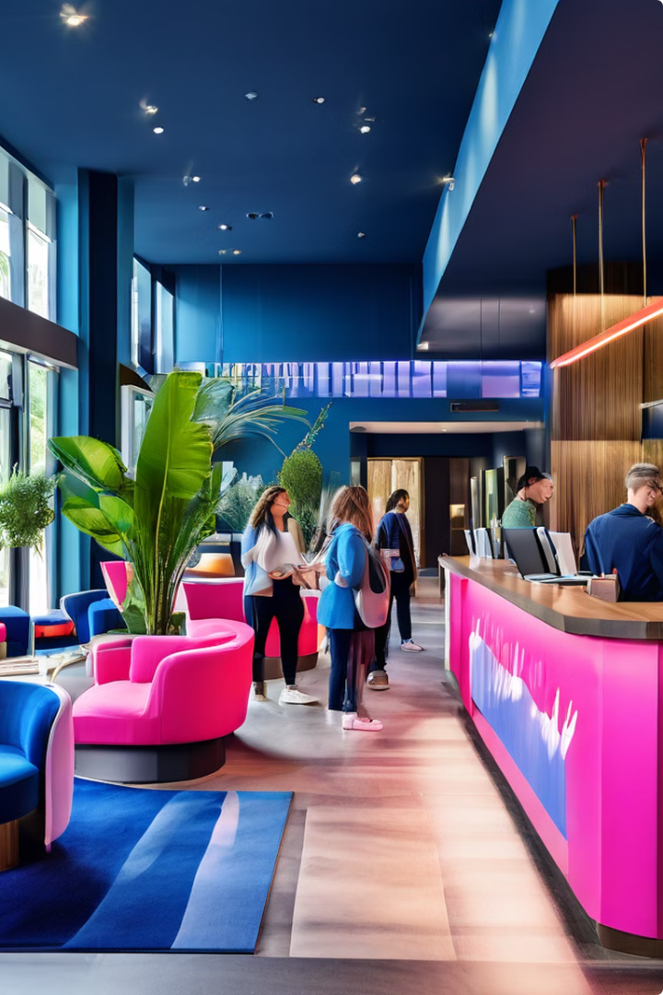



Comprehensive Market Strategy
Brand Positioning
We position Eco-Luxe Retreats as the premier destination for sustainable luxury travel experiences.
Multi-Channel Marketing
Our marketing strategy spans digital, social media, partnerships, and targeted outreach to eco-conscious consumers.
Localized Expansion
We plan to strategically expand our network of eco-lodges in desirable destinations, tailoring each to the local environment.

Slide 8
Competitive Landscape
Traditional Luxury Hotels
Eco-Lodges
Eco-Luxe Retreats
Offer high-end amenities but lack a strong focus on sustainability and immersive nature experiences.
Prioritize sustainability but often lack the elevated luxury and tailored guest experiences of Eco-Luxe Retreats.
Uniquely combine sustainable design, world-class amenities, and transformative nature-based activities.

Slide 9

Traction and Momentum
Early Adopter Bookings
Within the first year, we've achieved 85% occupancy across our initial eco-lodge portfolio.
Loyal Membership Base
Our subscription model has attracted over 10,000 annual members, providing a stable revenue stream.
Exceptional Guest Satisfaction
Guests have consistently rated their experience at Eco-Luxe Retreats as "exceptional," with a Net Promoter Score of 92.

Slide 10

Experienced and Passionate Team
Founder & CEO
Jane Doe
20+ years in hospitality and sustainability
Chief Operating Officer
John Smith
Formerly with Luxury Hotel Chain
Head of Sustainability
Sarah Johnson
PhD in Environmental Engineering
Director of Guest Experience
Michael Brown
Certified Nature Guide & Wellness Coach

Slide 11
The Financials
At Eco-Luxe Retreats, we have developed a robust financial model that underpins our long-term growth and sustainability. By leveraging our innovative subscription-based revenue stream and strategic cost management, we are poised to deliver exceptional returns for our investors.
Revenue Model
Annual Membership Fees, Nightly Rates, Ancillary Services
Gross Margins
65% on average, driven by efficient operations and sustainable partnerships
Profitability
Projected to achieve 25% EBITDA margins within 3 years of operation
Capital Requirements
Minimized through asset-light model and eco-lodge development partnerships
Investment Opportunity
Compelling risk-adjusted returns for investors seeking exposure to the booming eco-tourism sector
Our eco-lodges are designed to seamlessly integrate with their natural surroundings, offering guests a truly immersive and sustainable luxury experience. This translates to lower operational costs and higher profit margins compared to traditional resort models.

Slide 12



The Path Forward
Continued Expansion
Guest Experience Innovation
Strengthening Our Team
Eco-Luxe Retreats plans to steadily expand its network of eco-lodges across prime nature destinations, bringing our sustainable luxury experiences to more travelers worldwide.
We will continue to enhance our transformative nature-based programming and wellness offerings to deliver unparalleled experiences that enrich the mind, body, and spirit.
By attracting top talent in hospitality, sustainability, and experiential design, we will push the boundaries of what's possible in eco-luxury travel.

Slide 13
Connect with Eco-Luxe Retreats
Contact Us
Schedule a Consultation
Reach out to us at georgerubinga@gmail.com or +254725717270 to learn more about our eco-luxury experiences.
Book a call to discuss how Eco-Luxe Retreats can create a transformative nature-based getaway tailored to your preferences.
1
2
3
Connect Socially
Find us on Facebook, WhatsApp, and GitHub to stay up-to-date on our latest news and offerings.

